Slide 1
Full Stack Mania
Alex Engelmann
Jaison Heer
Kelen Quach

Slide 2
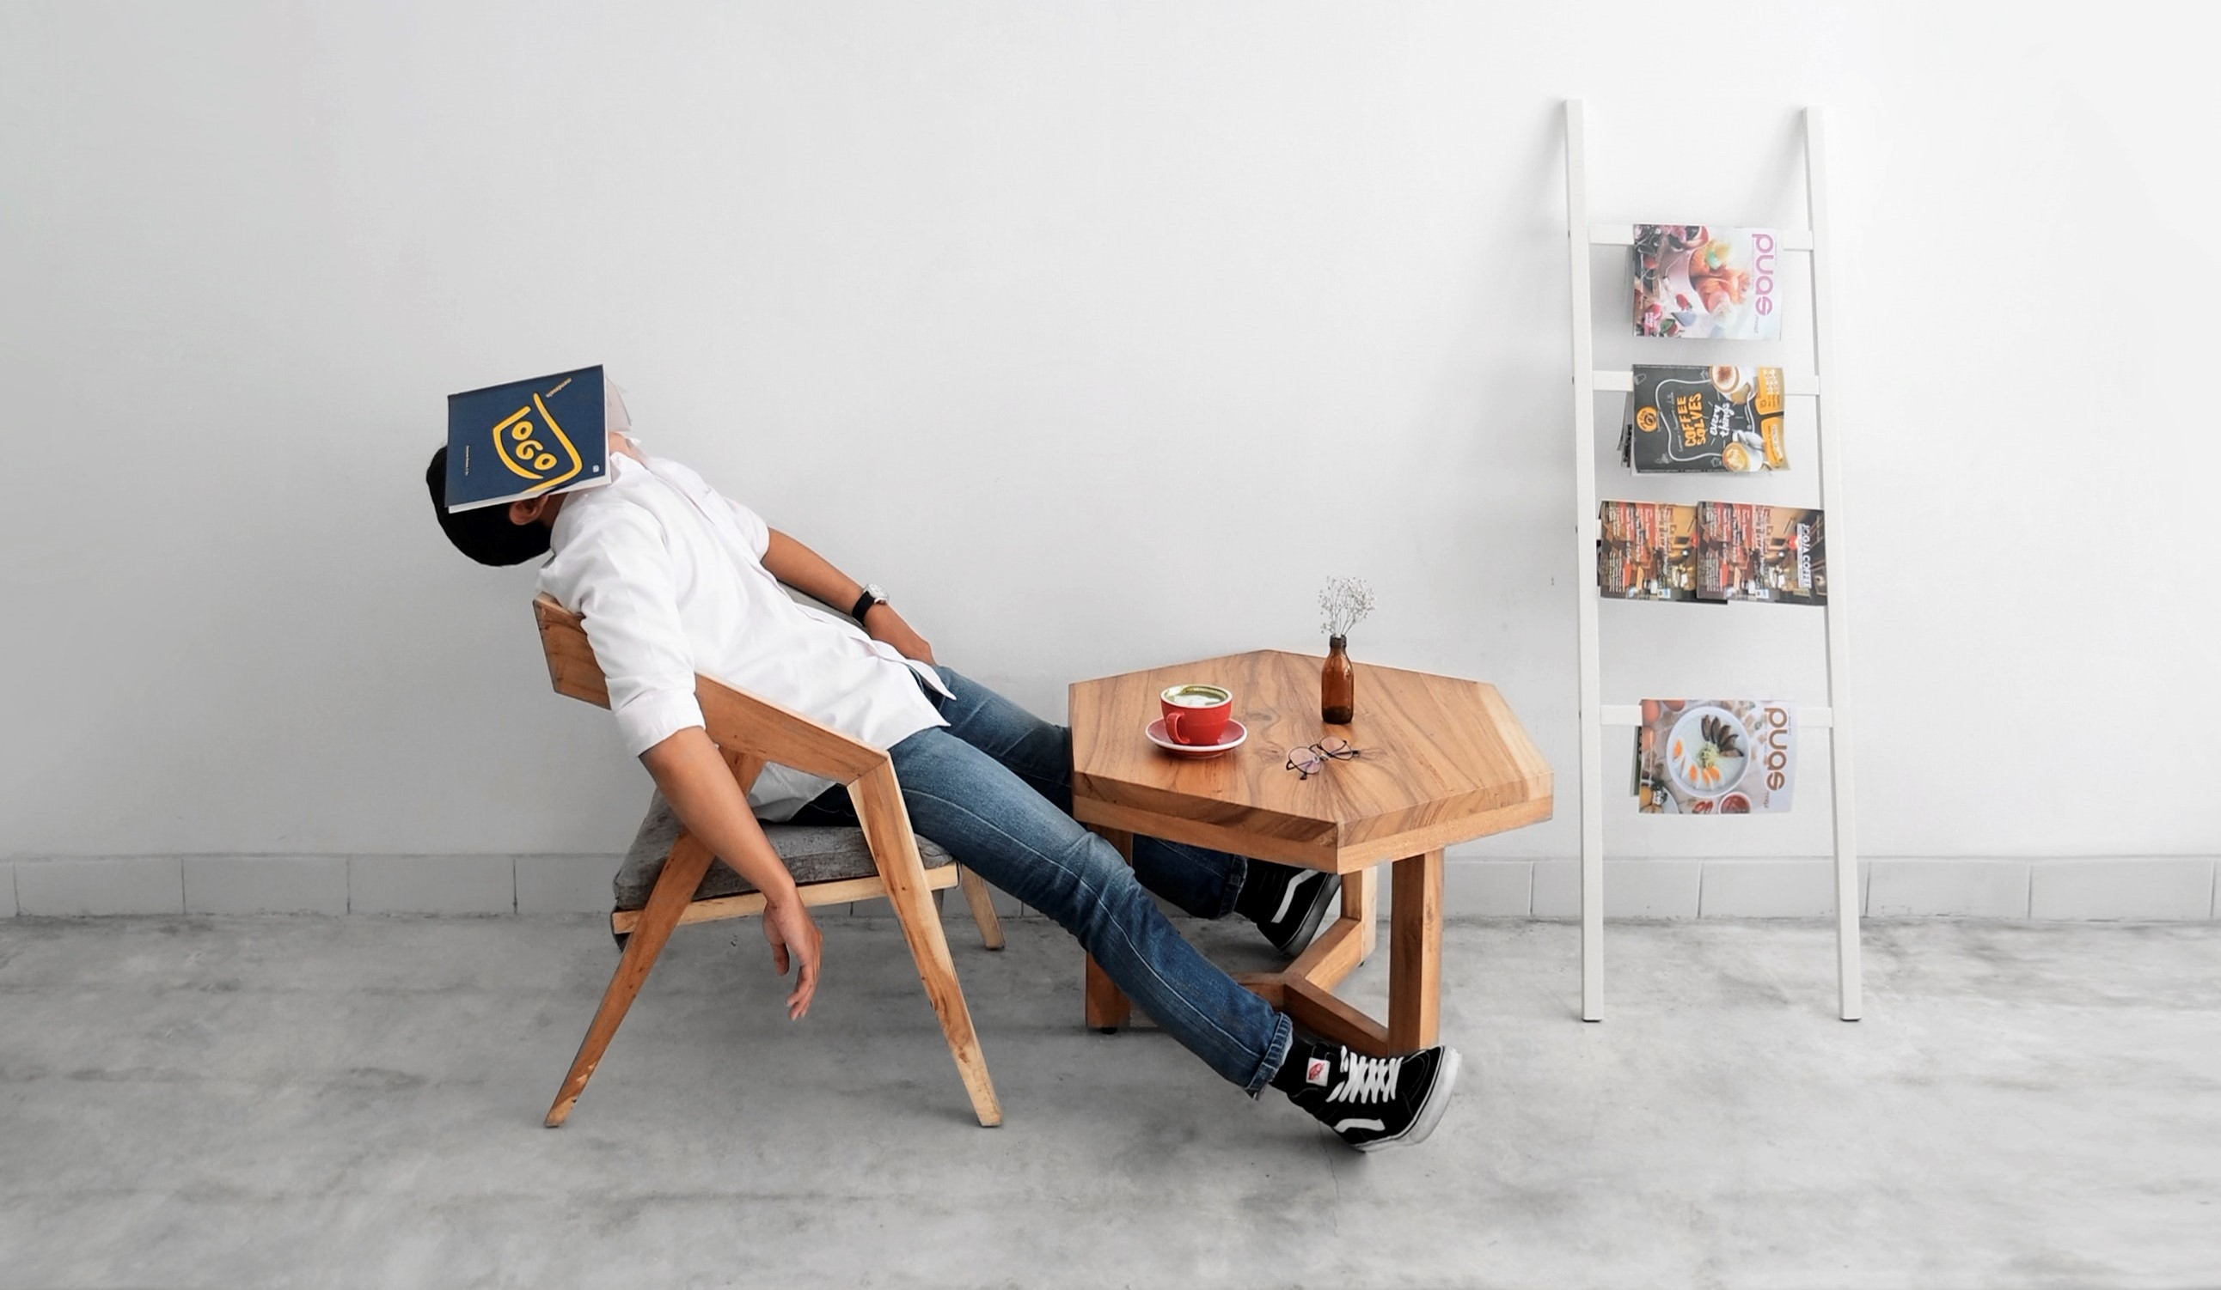
Grand Problem
People looking for
A game to play

Slide 3

Target Audience
Anyone in the world who wants to pass the time playing a simple game

Slide 4
Vision
To have a block catching game where people can compete for high scores.

Slide 5
Minimum Viable Product (MVP)
A website that allows users to play a game and log their high scores

Slide 6
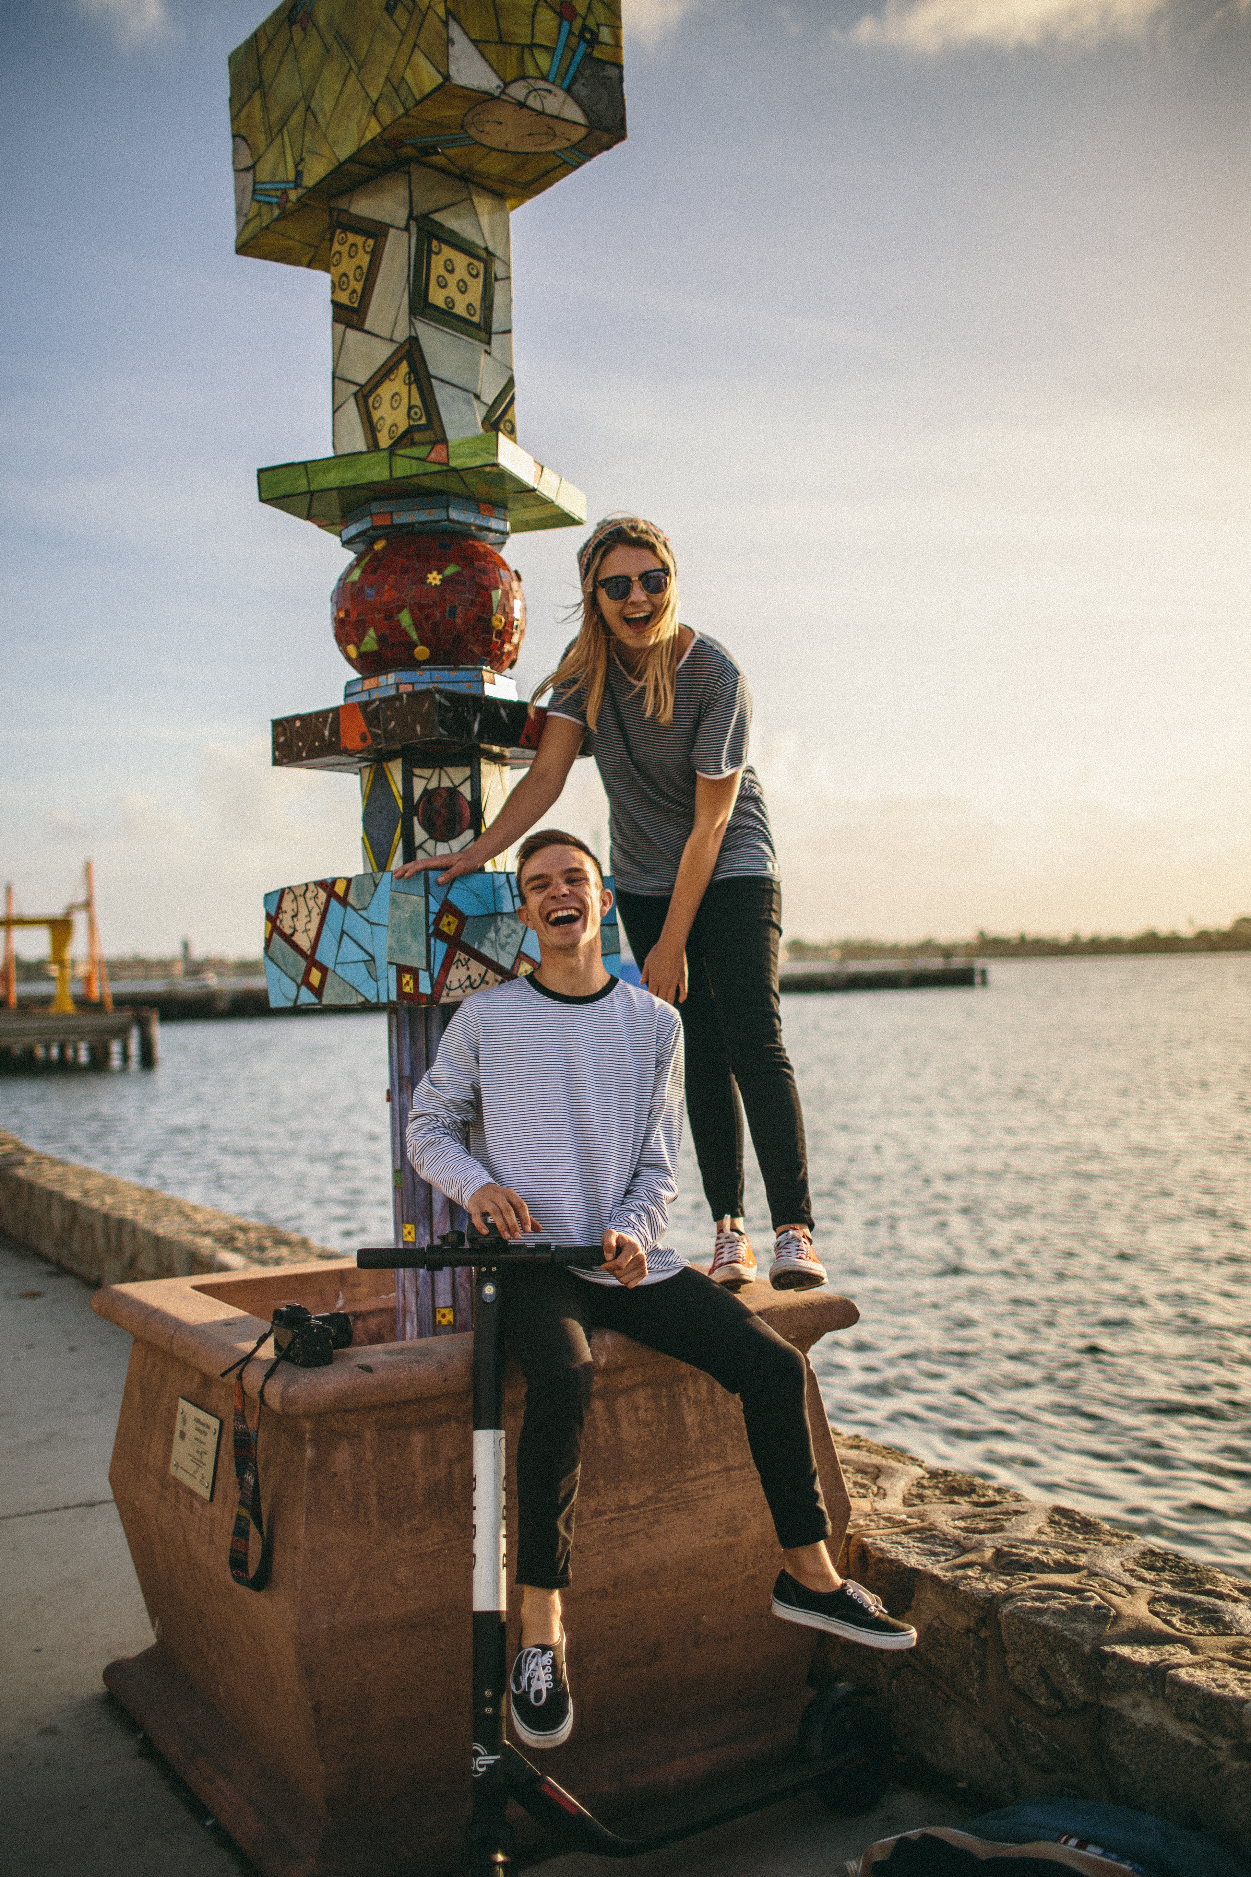
User Stories
If I use the app, I want to be able to see my friends’ high scores
I want to catch as many technologies as possible

Slide 7




Implemented Technologies
Node
Express
Phaser
Sequelize
MySQL

Slide 8
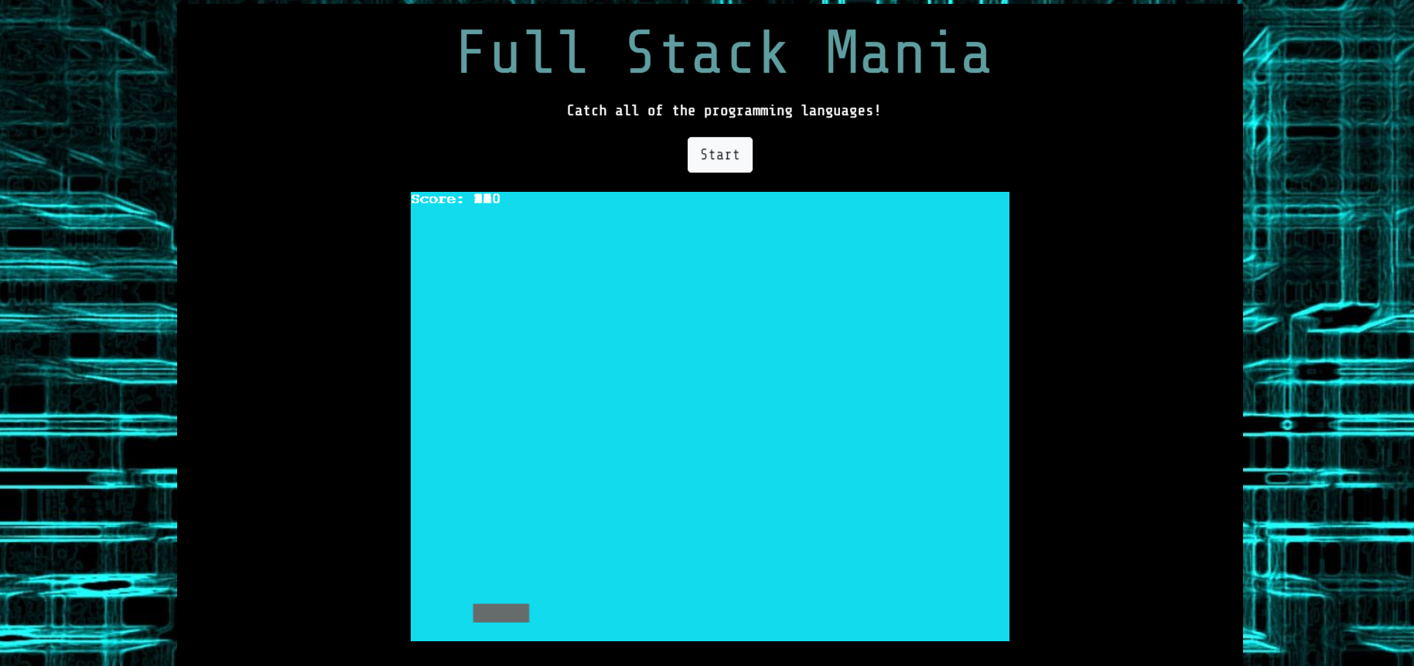
Demonstration

Slide 9
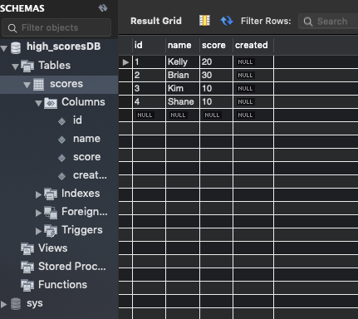
High Score Data
Using MySQL to store player names and high scores

Slide 10

Limitations
Only made for mobile – no touch controls
Left space to add arrows to touch events

Slide 11
Conclusion
We created a prototype that satisfies most of our MVP goal

Slide 12

The Path Ahead
Add more falling objects with more logos
Set game over condition
Log each player’s high score at end of game
Add time stamps to high scores
A more animated UI

Slide 13

Questions

